Slide 1

Introduction to Probabilistic Machine Learning
Ralf Herbrich, Jakob Walter
Probability

Slide 2


Hochschulgruppe
Nightline Potsdam
Dein Anliegen, egal ob groß oder klein, ist einen Anruf oder ein Chat-Gespräch wert.
Wir führen unsere Gespräche wertschätzend und unvoreingenommen.
Du bleibst dabei anonym.
Sonntags bis donnerstags von 21 bis 24 Uhr unter 0331 977 1834
Wir sind über den Chat erreichbar unter: http://nightline-potsdam.de/

Slide 3
Course Setup
Goal: Stimulate interest in method development for machine learning algorithms
We will pick the pace that helps you to get excited; please interrupt and ask questions!
Format: We have one topic per week with a lecture and tutorial
Lecture: Monday, 9:15am – 10:45am (L-E.03)
Tutorial: Tuesday: 1:30pm – 3:00pm (L-E.03)
Tutorial: Supporting the material of the lecture with exercises
Handed out every week on Monday; try to solve for yourself during the week!
In the tutorial, Jakob will talk through the solution and answer any questions
Assignment: Three big assignments with 4 weeks to solve them (groups of two). They account for 40% of all points
Arithmetic Coding (10 points): April 24 – May 19
Gaussian Processes (15 points): June 5 – June 30
TrueSkill (15 points): June 26 – July 21
Exam (60 points): Counts for 60% of all points; 90-120 minutes long (w/c July 24)

Slide 4
Course Material
Books: All our material and communication will happen over Moodle
Bishop, C. Pattern Recognition and Machine Learning. Springer. 2006.
MacKay, D. Information Theory, Inference, and Learning Algorithms. CUP. 2003
Moodle: Share our lecture slides, tutorials, solutions
Location: https://moodle.hpi.de/course/view.php?id=430
Announcements: https://moodle.hpi.de/mod/forum/view.php?id=14880
GitHub Repository: Supporting material as well as code samples
Location: https://github.com/HPI-Artificial-Intelligence-Teaching/pml-sose2023
If you find mistakes, please submit issues and pull requests
GitHub Classrooms: Used for all our assignments
If you do not have a GitHub account, please create one now
Find a team members as assignments are solved in groups of two
More details tomorrow in the first tutorial

Slide 5
Course Structure
Probability Theory (Unit 1)
Information Theory (Unit 2a)
Inference & Decision Theory (Unit 2b)
Linear Basis Function Models (Unit 3a)
Linear Algebra (Unit 3b)
Bayesian Regression (Unit 4a)
Gaussian Process Regression (Unit 4b)
Bayesian Classification (Unit 5a)
Gaussian Process Classification (Unit 5b)
Bayesian Ranking (Unit 6)
Bayesian Clustering (Unit 7)
Bayesian Methods for Sequence Data (Unit 8)

Slide 6

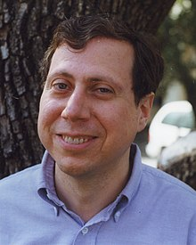


Julia
2012 developed by Jeff Bezanson, Alan Edelman, Stefan Karpinski and Viral B. Shah at MIT
Used for numerical and scientific computing with high performance
Execution speed is similar to C and FORTRAN
Hierarchical and parameterized type system as well as method overloading („multiple dispatching“) as central concepts
Native calls from C-(compiled) code possible (without wrappers)
Unicode is efficiently supported (e.g., UTF-8)
Alongside C, C++ and FORTRAN, the only programming language that has entered the “PetaFlop Club“
Jeff Bezanson (1981– )
Alan Edelman (1963 – )
Stefan Karpsinski (1981– )
Viral Shah

Slide 7
Overview
History of Machine Learning
Probability in Machine Learning
Probability Theory
Probability Distributions

Slide 8
Overview
History of Machine Learning
Probability in Machine Learning
Probability Theory
Probability Distributions

Slide 9
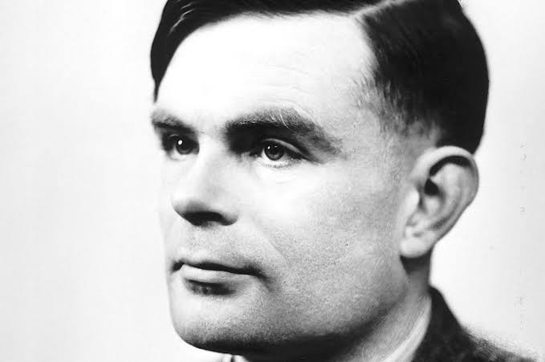
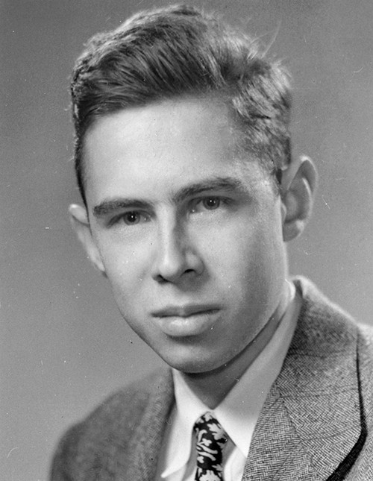
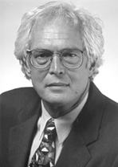
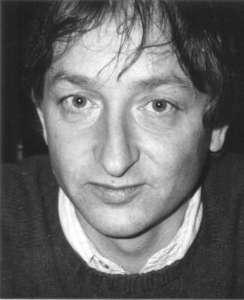



History of Machine Learning
1995: Support Vector Machines
2012: Deep Neural Networks
1967: Nearest Neighbors
1986: Neural Networks
2000: Graphical Models
1950: Turing Test
1957: Perceptrons
Alan Turing
Vladimir Vapnik
Michael Jordan
Frank Rosenblatt
Geoffrey Hinton
Thomas Cover
Yann LeCun, Geoffrey Hinton, Yoshua Bengio

Slide 10
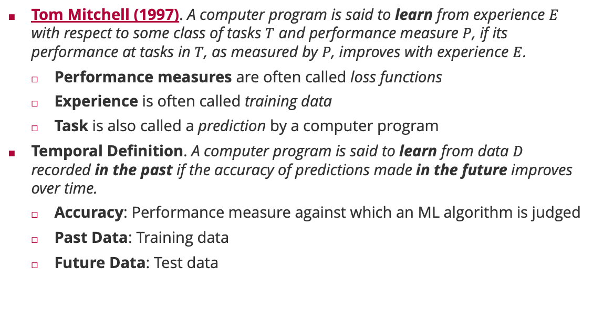
Machine Learning: Definition
Tom Mitchell (1997). A computer program is said to learn from experience $E$ with respect to some class of tasks $T$ and performance measure $P$, if its performance at tasks in $T$, as measured by $P$, improves with experience $E$.
Performance measures are often called loss functions
Experience is often called training data
Task is also called a prediction by a computer program
Temporal Definition. A computer program is said to learn from data $D$ recorded in the past if the accuracy of predictions made in the future improves over time.
Accuracy: Performance measure against which an ML algorithm is judged
Past Data: Training data
Future Data: Test data

Slide 11

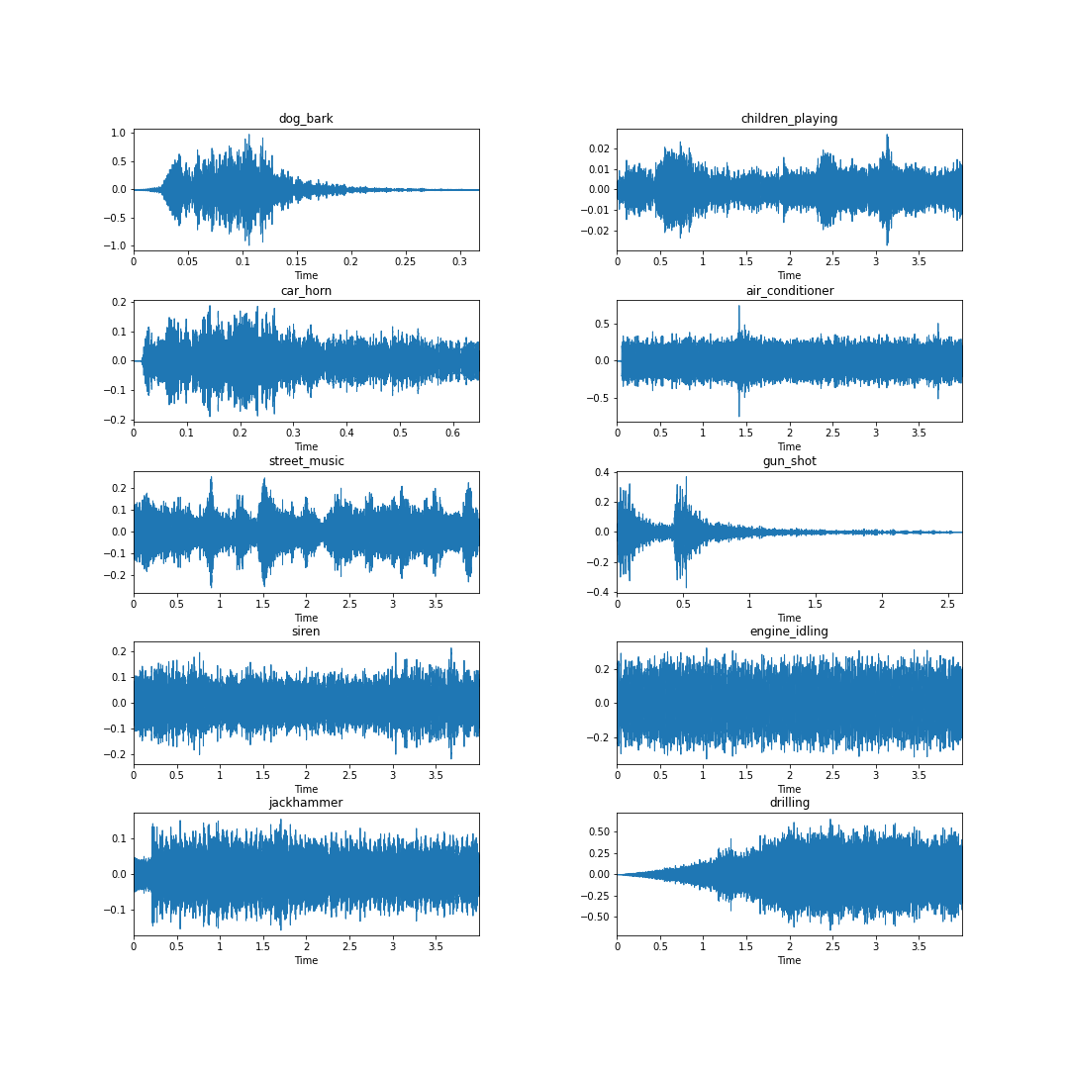
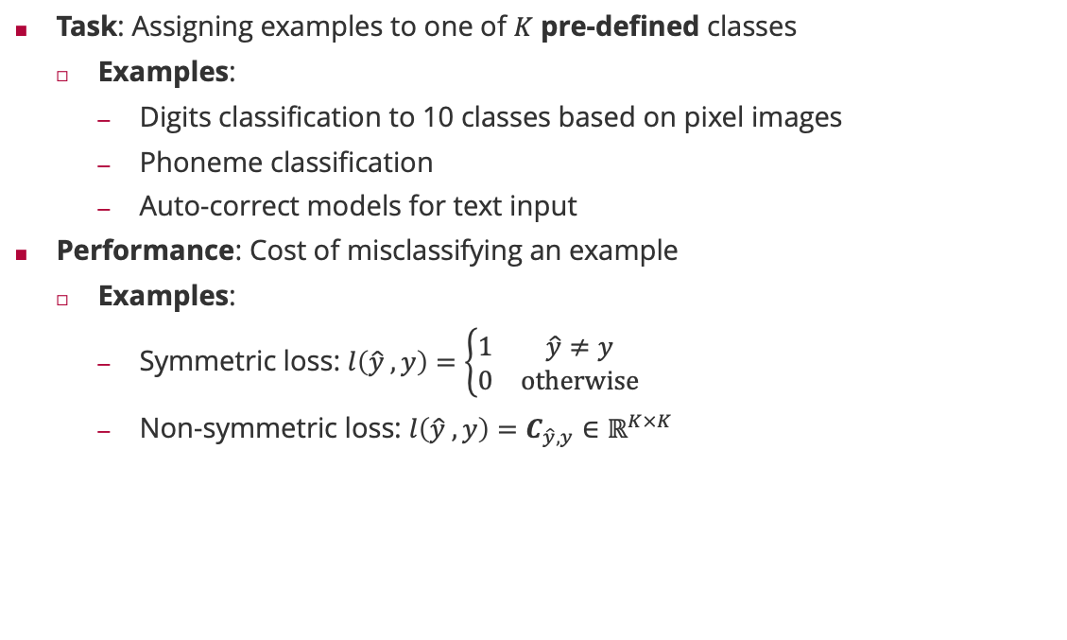
Machine Learning : Classification
Task: Assigning examples to one of $K$ pre-defined classes
Examples:
Digits classification to 10 classes based on pixel images
Phoneme classification
Auto-correct models for text input
Performance: Cost of misclassifying an example
Examples:
Symmetric loss: $l\left(\hat{y} ,y\right)=\left\{\begin{matrix}1 & \hat{y}≠y \\ 0 & otherwise\end{matrix}\right.$
Non-symmetric loss: $l\left(\hat{y} ,y\right)=C_{\hat{y},y}∈ℝ^{K×K}$

Slide 12
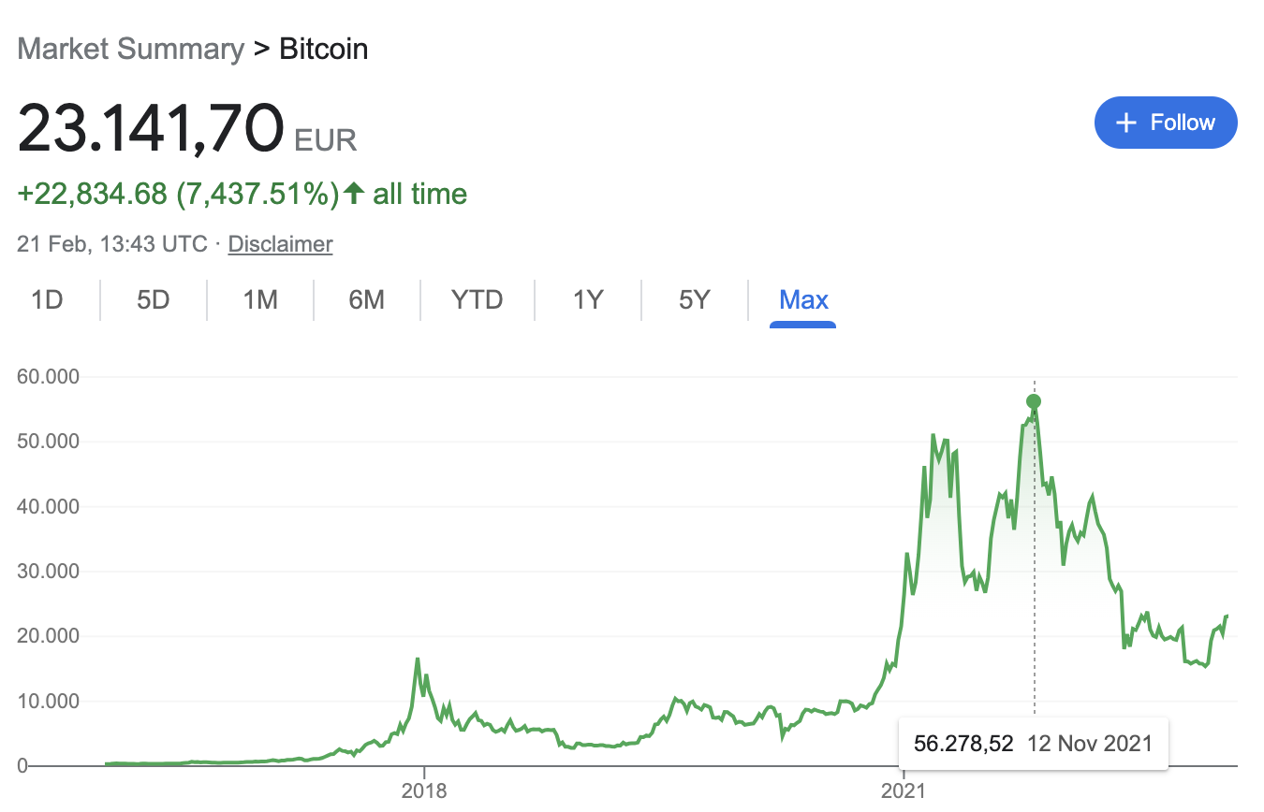
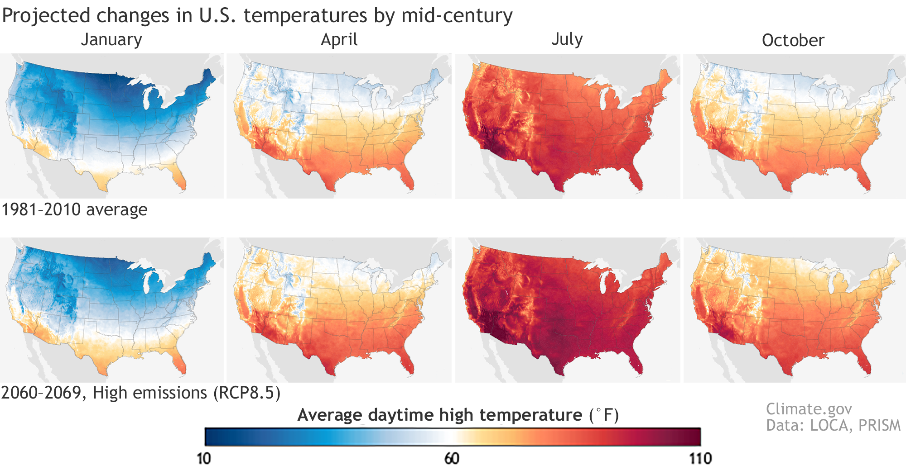
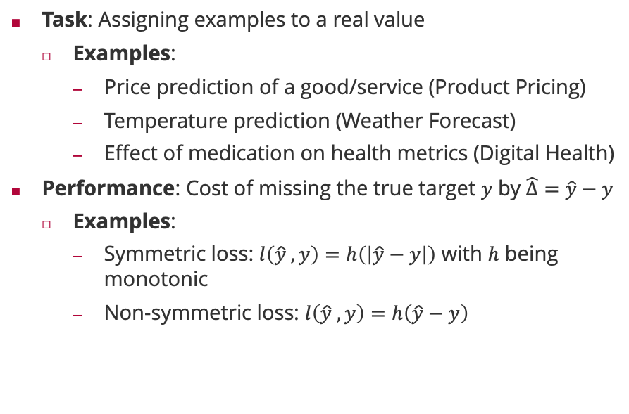
Machine Learning : Regression
Task: Assigning examples to a real value
Examples:
Price prediction of a good/service (Product Pricing)
Temperature prediction (Weather Forecast)
Effect of medication on health metrics (Digital Health)
Performance: Cost of missing the true target $y$ by $\hat{Δ}=\hat{y}−y$
Examples:
Symmetric loss: $l\left(\hat{y} ,y\right)=h\left(\left|\hat{y}−y\right|\right)$ with $h$ being monotonic
Non-symmetric loss: $l\left(\hat{y} ,y\right)=h\left(\hat{y}−y\right)$

Slide 13
Overview
History of Machine Learning
Probability in Machine Learning
Probability Theory
Probability Distributions

Slide 14
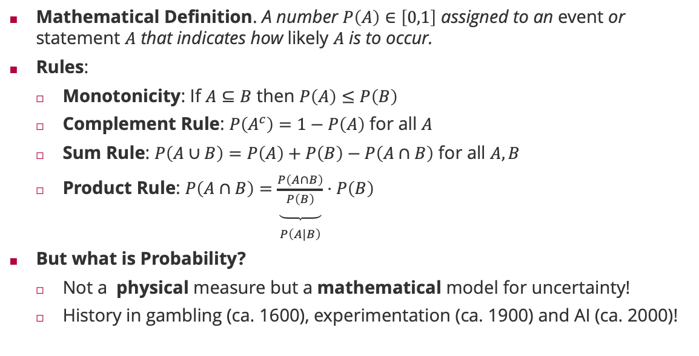
Probability
Mathematical Definition. A number $P\left(A\right)∈\left[0,1\right]$ assigned to an event or statement $A$ that indicates how likely $A$ is to occur.
Rules:
Monotonicity: If $A⊆B$ then $P\left(A\right)≤P\left(B\right)$
Complement Rule: $P\left(A^{c}\right)=1−P\left(A\right)$ for all $A$
Sum Rule: $P\left(A∪B\right)=P\left(A\right)+P\left(B\right)−P\left(A∩B\right)$ for all $A,B$
Product Rule: $P\left(A∩B\right)=\underset{\begin{aligned} \\ P\left(A|B\right)\end{aligned}}{\underbrace{\frac{P\left(A∩B\right)}{P\left(B\right)}}}⋅P\left(B\right)$
But what is Probability?
Not a physical measure but a mathematical model for uncertainty!
History in gambling (ca. 1600), experimentation (ca. 1900) and AI (ca. 2000)!

Slide 15
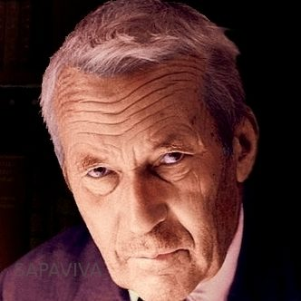
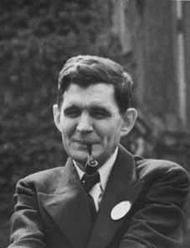
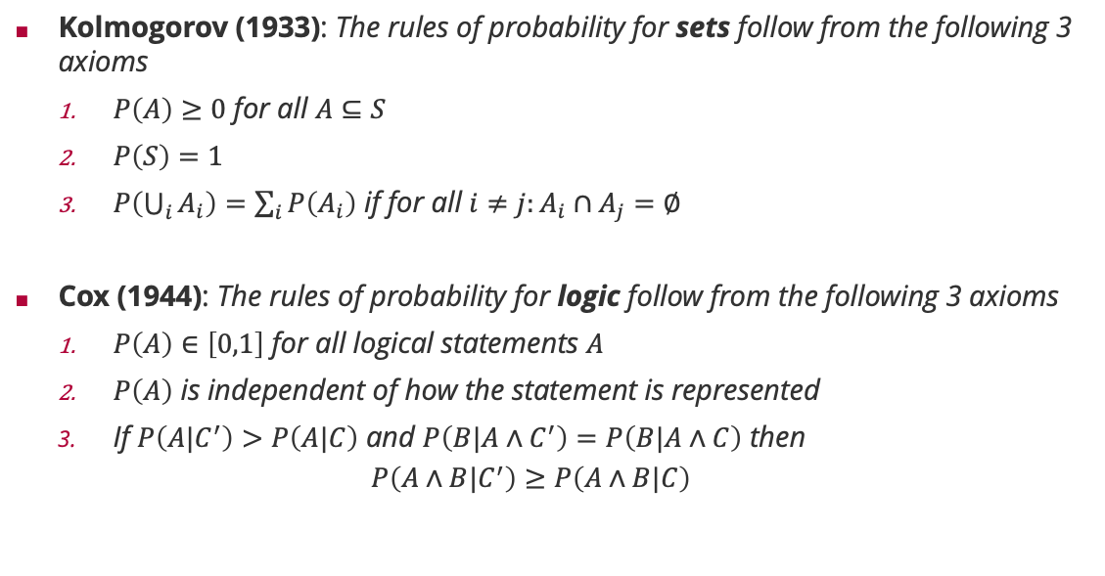
Frequentist vs. Subjective Probabilities
Kolmogorov (1933): The rules of probability for sets follow from the following 3 axioms
$P\left(A\right)≥0$ for all $A⊆S$
$P\left(S\right)=1$
$P\left(\bigcup_{i}{A_{i}}\right)=\sum_{i}{P\left(A_{i}\right)}$ if for all $i≠j:A_{i}∩A_{j}=∅$
Cox (1944): The rules of probability for logic follow from the following 3 axioms
$P\left(A\right)∈\left[0,1\right]$ for all logical statements $A$
$P\left(A\right)$ is independent of how the statement is represented
If $P\left(A|C^{′}\right)>P\left(A|C\right)$ and $P\left(B|A∧C^{′}\right)=P\left(B|A∧C\right)$ then
$$P\left(A∧B|C^{′}\right)≥P\left(A∧B|C\right)$$
Andrey Kolmogorov (1903 – 1987)
Richard Threlkeld Cox (1898 – 1991)

Slide 16
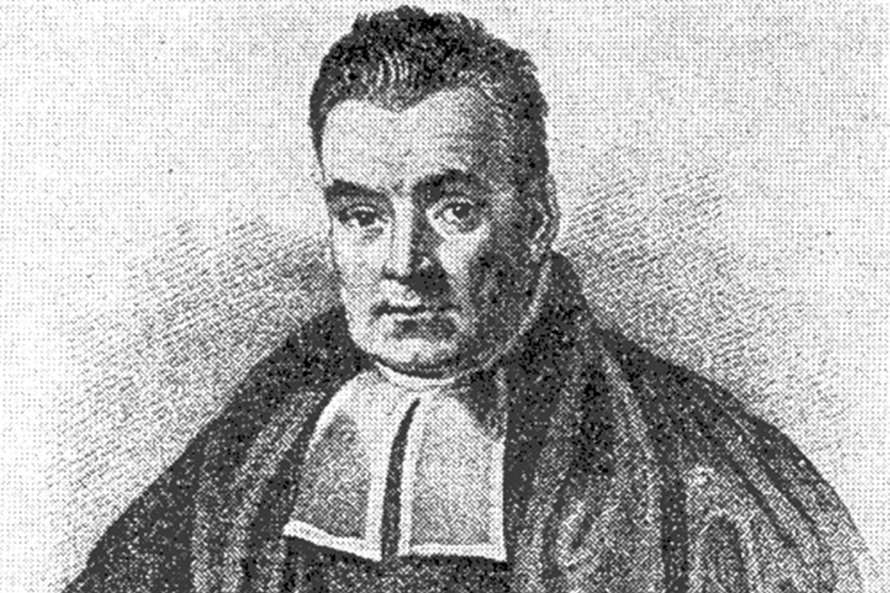
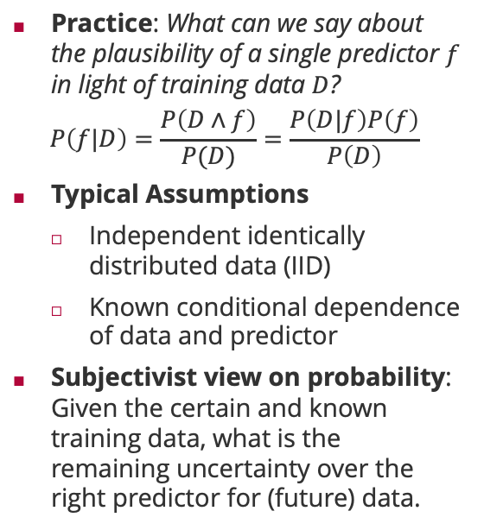
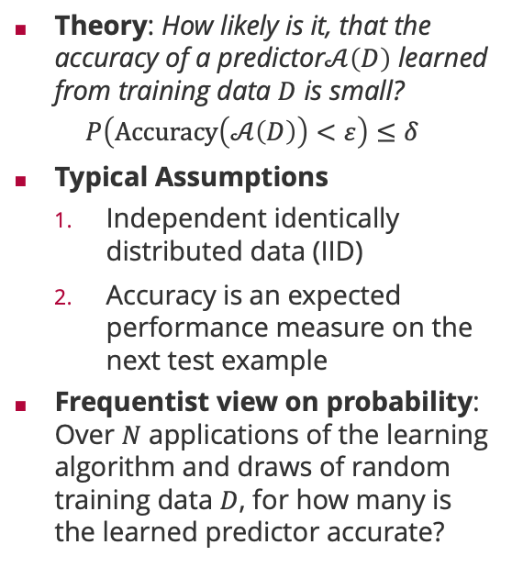
The Role of Probability in Machine Learning
Theory: How likely is it, that the accuracy of a predictor$𝒜\left(D\right)$ learned from training data $D$ is small?
$$P\left(Accuracy\left(𝒜\left(D\right)\right)<ε\right)≤δ$$
Typical Assumptions
Independent identically distributed data (IID)
Accuracy is an expected performance measure on the next test example
Frequentist view on probability: Over $N$ applications of the learning algorithm and draws of random training data $D$, for how many is the learned predictor accurate?
Practice: What can we say about the plausibility of a single predictor $f$ in light of training data $D$?
$$P\left(f|D\right)=\frac{P\left(D∧f\right)}{P(D)}=\frac{P\left(D|f\right)P\left(f\right)}{P\left(D\right)}$$
Typical Assumptions
Independent identically distributed data (IID)
Known conditional dependence of data and predictor
Subjectivist view on probability: Given the certain and known training data, what is the remaining uncertainty over the right predictor for (future) data.
(Rev) Thomas Bayes (1701 – 1961)

Slide 17
Overview
History of Machine Learning
Probability in Machine Learning
Probability Theory
Probability Distributions

Slide 18
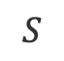

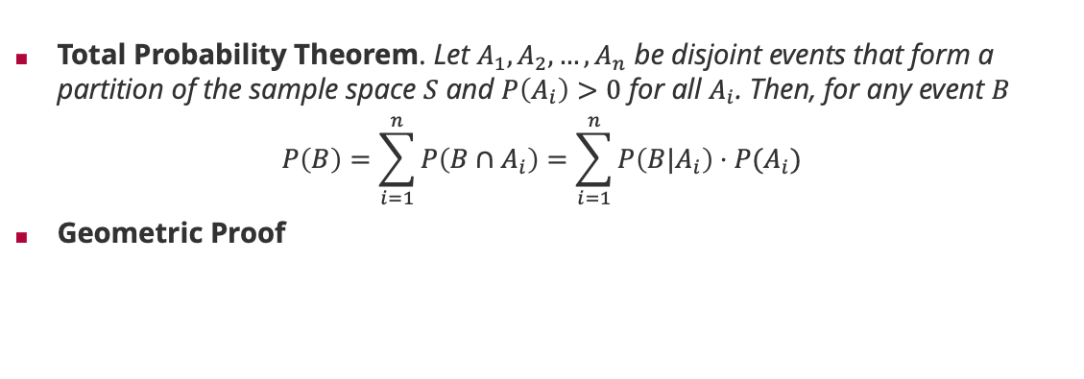
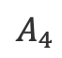
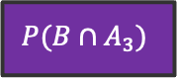
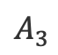

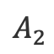
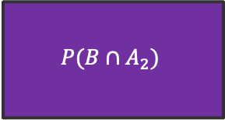
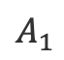
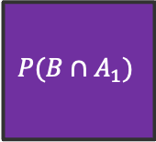
Probability Theory: Sum Rule
Total Probability Theorem. Let $A_{1},A_{2},…,A_{n}$ be disjoint events that form a partition of the sample space $S$ and $P\left(A_{i}\right)>0$ for all $A_{i}$. Then, for any event $B$
$$P\left(B\right)=\sum_{i=1}^{n}{P\left(B∩A_{i}\right)}=\sum_{i=1}^{n}{P\left(B|A_{i}\right)⋅P(A_{i})}$$
Geometric Proof
$$A_{1}$$
$$A_{2}$$
$$P(B∩A_{1})$$
$$B$$
$$P(B∩A_{2})$$
$$P(B∩A_{4})$$
$$P(B∩A_{3})$$
$$A_{4}$$
$$A_{3}$$
$$S$$
Notes:
Central concept for probabilistic machine learning when summing out latent variables that “cause” the data!

Slide 19
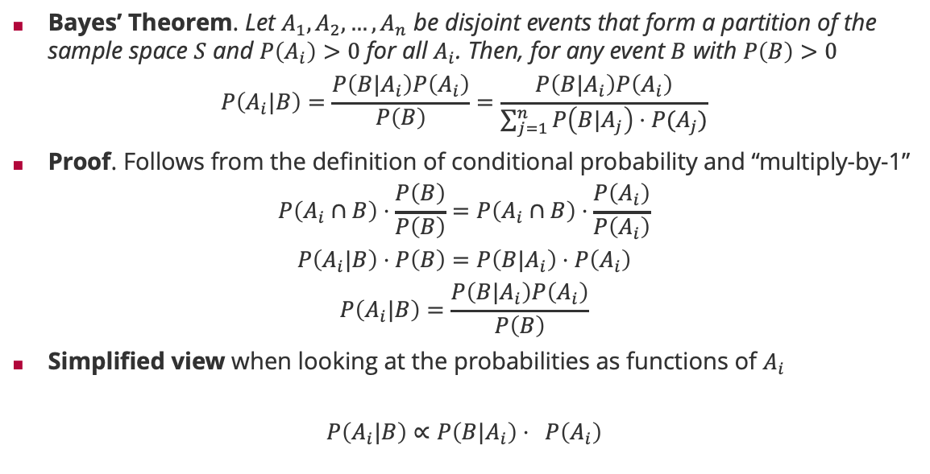
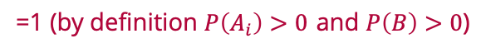
Probability Theory: Bayes Rule
Bayes’ Theorem. Let $A_{1},A_{2},…,A_{n}$ be disjoint events that form a partition of the sample space $S$ and $P\left(A_{i}\right)>0$ for all $A_{i}$. Then, for any event $B$ with $P\left(B\right)>0$
$$P\left(A_{i}|B\right)=\frac{P\left(B|A_{i}\right)P\left(A_{i}\right)}{P\left(B\right)}=\frac{P\left(B|A_{i}\right)P\left(A_{i}\right)}{\sum_{j=1}^{n}{P\left(B|A_{j}\right)⋅P(A_{j})}}$$
Proof. Follows from the definition of conditional probability and “multiply-by-1”
$$P\left(A_{i}∩B\right)⋅\frac{P\left(B\right)}{P\left(B\right)}=P\left(A_{i}∩B\right)⋅\frac{P\left(A_{i}\right)}{P\left(A_{i}\right)}$$
$$P\left(A_{i}|B\right)⋅P\left(B\right)=P\left(B|A_{i}\right)⋅P\left(A_{i}\right)$$
$$P\left(A_{i}|B\right)=\frac{P\left(B|A_{i}\right)P\left(A_{i}\right)}{P\left(B\right)}$$
Simplified view when looking at the probabilities as functions of $A_{i}$
$$P\left(A_{i}|B\right)∝P\left(B|A_{i}\right)⋅ P\left(A_{i}\right)$$
=1 (by definition $P\left(A_{i}\right)>0$ and $P\left(B\right)>0$)
(by definition of conditional probability)
posterior
likelihood
prior
Notes:
Central concept for probabilistic machine learning when $A_{i}$ is the event “predictor $f_{i}$ is the predictor of the dataset” and $B$ is the event “data set $D$ is observed”.

Slide 20
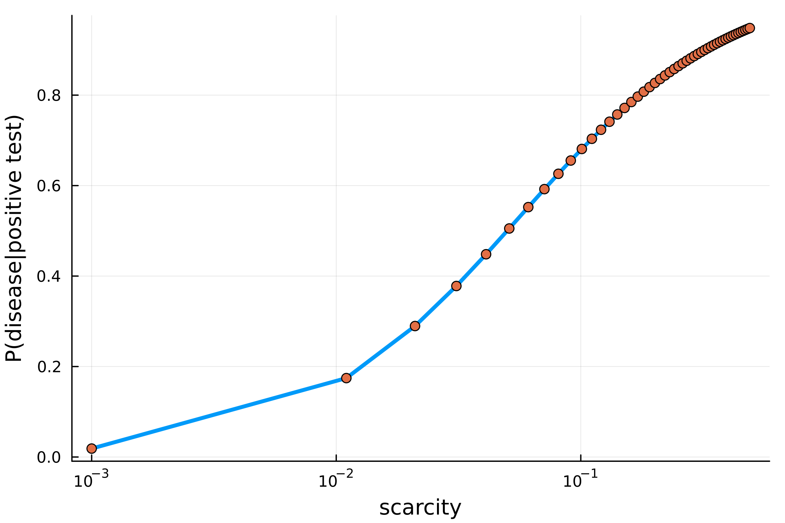
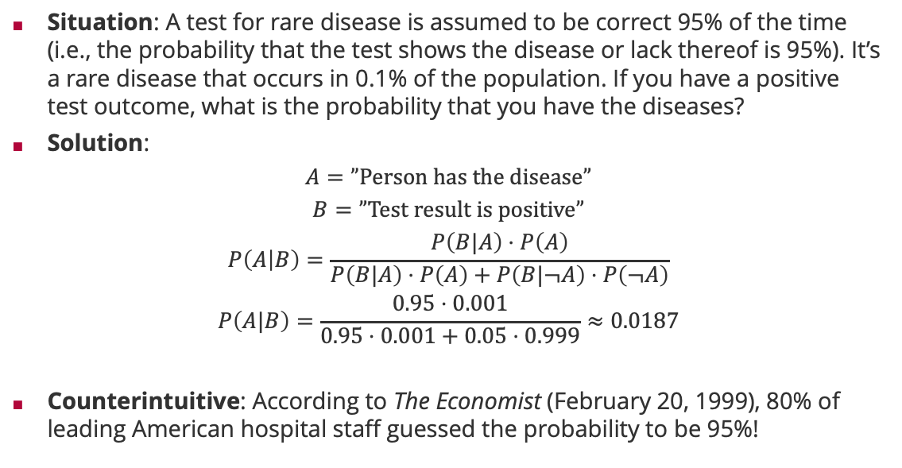
Bayes Rule: False-Positive Puzzle
Situation: A test for rare disease is assumed to be correct 95% of the time (i.e., the probability that the test shows the disease or lack thereof is 95%). It’s a rare disease that occurs in 0.1% of the population. If you have a positive test outcome, what is the probability that you have the diseases?
Solution:
$$A=”Person has the disease”$$
$$B=”Test result is positive”$$
$$P\left(A | B\right)=\frac{P\left(B|A\right)⋅P\left(A\right)}{P\left(B|A\right)⋅P\left(A\right)+P\left(B|¬A\right)⋅P\left(¬A\right)}$$
$$P\left(A|B\right)=\frac{0.95⋅0.001}{0.95⋅0.001+0.05⋅0.999}≈0.0187$$
Counterintuitive: According to The Economist (February 20, 1999), 80% of leading American hospital staff guessed the probability to be 95%!

Slide 21
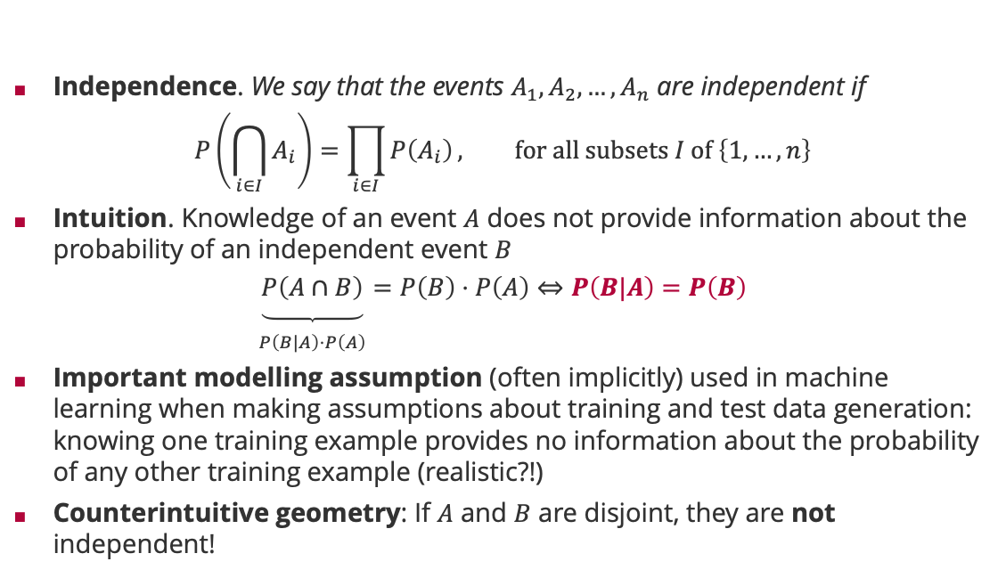
Probability Theory: Independence
Independence. We say that the events $A_{1},A_{2},…,A_{n}$ are independent if
$$P\left(\bigcap_{i∈I}{A_{i}}\right)=\prod_{i∈I}{P\left(A_{i}\right)}, for all subsets I of \left\{1,…,n\right\}$$
Intuition. Knowledge of an event $A$ does not provide information about the probability of an independent event $B$
$$\underset{\begin{aligned} \\ P\left(B|A\right)⋅P\left(A\right)\end{aligned}}{\underbrace{P\left(A∩B\right)}}=P\left(B\right)⋅P\left(A\right)⇔P\left(B|A\right)=P\left(B\right)$$
Important modelling assumption (often implicitly) used in machine learning when making assumptions about training and test data generation: knowing one training example provides no information about the probability of any other training example (realistic?!)
Counterintuitive geometry: If $A$ and $B$ are disjoint, they are not independent!

Slide 22
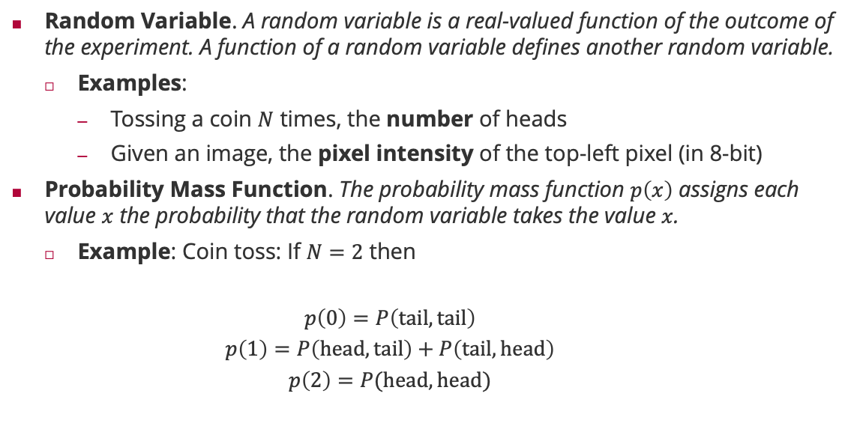
Probability Theory: Random Variable
Random Variable. A random variable is a real-valued function of the outcome of the experiment. A function of a random variable defines another random variable.
Examples:
Tossing a coin $N$ times, the number of heads
Given an image, the pixel intensity of the top-left pixel (in 8-bit)
Probability Mass Function. The probability mass function $p\left(x\right)$ assigns each value $x$ the probability that the random variable takes the value $x$.
Example: Coin toss: If $N=2$ then
$$p\left(0\right)=P\left(tail,tail\right)$$
$$p\left(1\right)=P\left(head,tail\right)+P\left(tail,head\right)$$
$$p\left(2\right)=P(head,head)$$

Slide 23

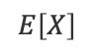
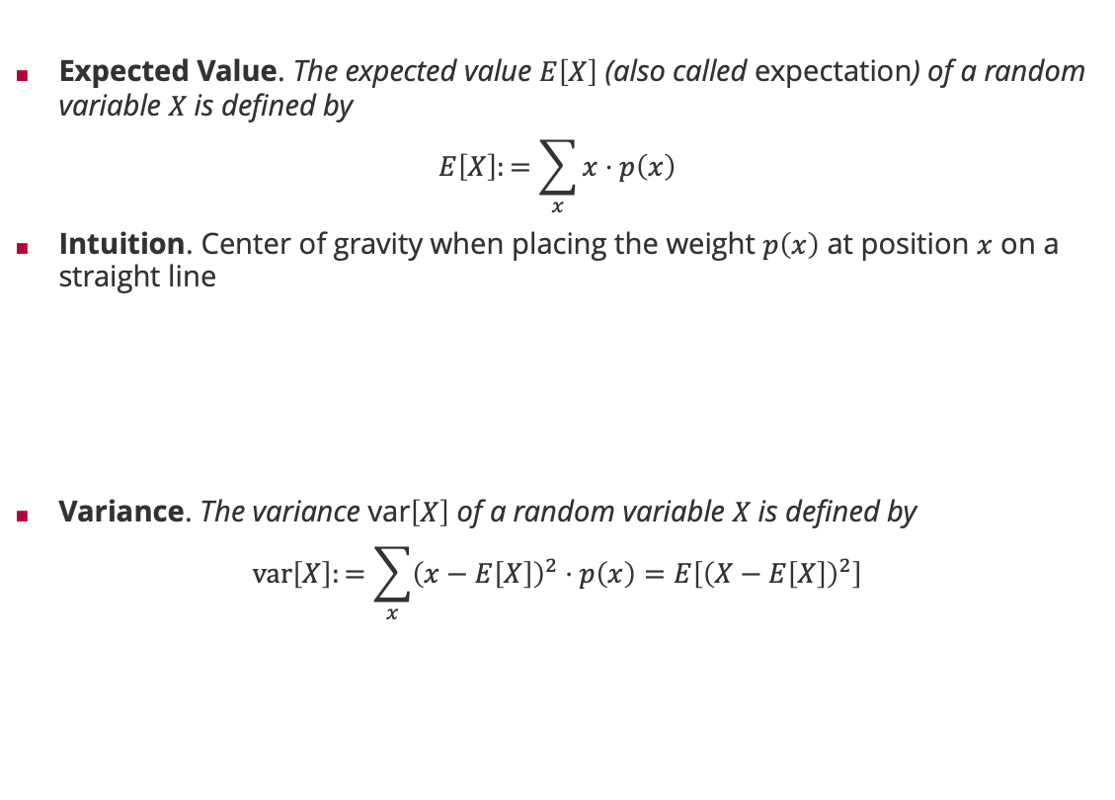


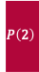
Probability Theory: Expectation and Variance
Expected Value. The expected value $E\left[X\right]$ (also called expectation) of a random variable $X$is defined by
$$E\left[X\right]:=\sum_{x}{x⋅p\left(x\right)}$$
Intuition. Center of gravity when placing the weight $p\left(x\right)$ at position $x$ on a straight line
Variance. The variance var$\left[X\right]$ of a random variable $X$is defined by
$$var\left[X\right]:=\sum_{x}{{\left(x−E\left[X\right]\right)}^{2}⋅p\left(x\right)=E\left[{\left(X−E\left[X\right]\right)}^{2}\right]}$$
$$P\left(1\right)$$
$$P\left(3\right)$$
$$P\left(2\right)$$
$$P\left(4\right)$$
$$E\left[X\right]$$

Slide 24
Overview
History of Machine Learning
Probability in Machine Learning
Probability Theory
Probability Distributions

Slide 25
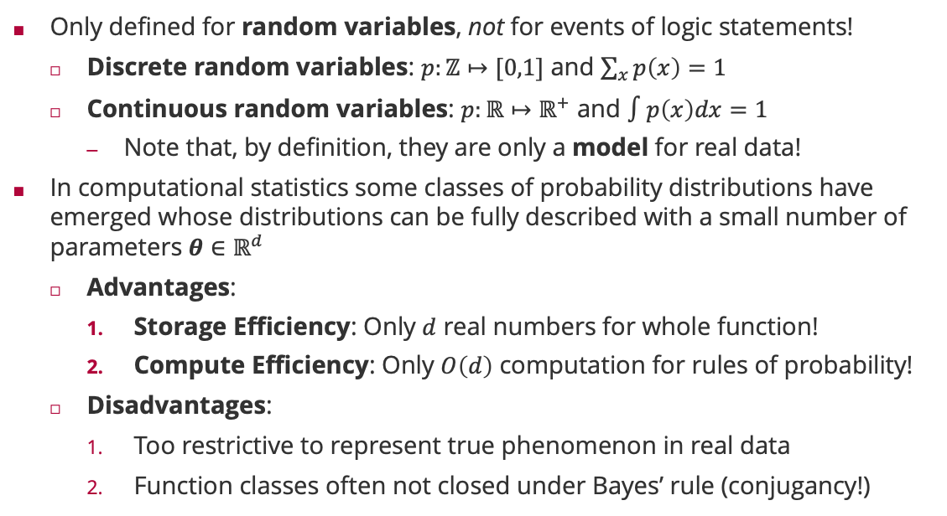
Probability Distributions
Only defined for random variables, not for events of logic statements!
Discrete random variables: $p:ℤ↦[0,1]$ and $\sum_{x}{p\left(x\right)}=1$
Continuous random variables: $p:ℝ↦ℝ^{+}$ and $∫p\left(x\right)dx=1$
Note that, by definition, they are only a model for real data!
In computational statistics some classes of probability distributions have emerged whose distributions can be fully described with a small number of parameters $θ∈ℝ^{d}$
Advantages:
Storage Efficiency: Only $d$ real numbers for whole function!
Compute Efficiency: Only $O\left(d\right)$ computation for rules of probability!
Disadvantages:
Too restrictive to represent true phenomenon in real data
Function classes often not closed under Bayes’ rule (conjugancy!)

Slide 26

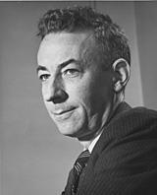
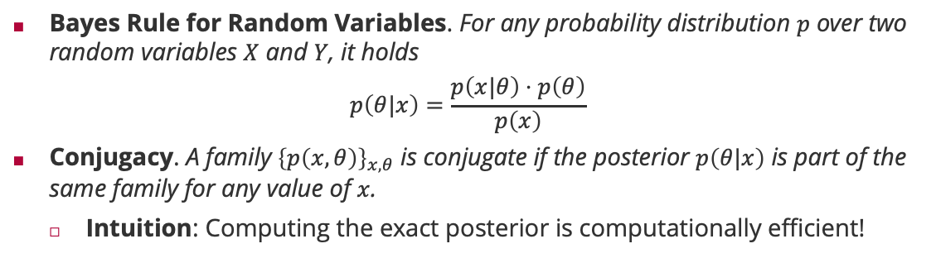
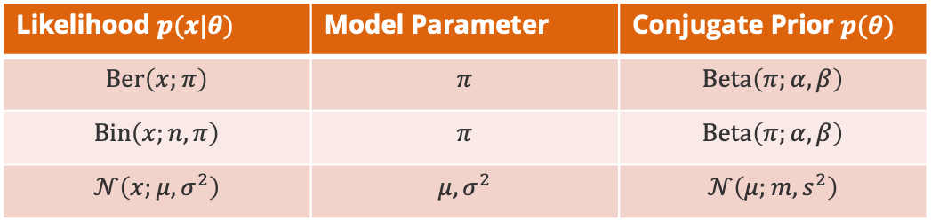
Probability Distributions: Conjugacy
Bayes Rule for Random Variables. For any probability distribution $p$ over two random variables $X$ and $Y$, it holds
$$p\left(θ|x\right)=\frac{p\left(x|θ\right)⋅p\left(θ\right)}{p\left(x\right)}$$
Conjugacy. A family ${\left\{p\left(x,θ\right)\right\}}_{x,θ}$ is conjugate if the posterior $p\left(θ|x\right)$ is part of the same family for any value of $x$.
Intuition: Computing the exact posterior is computationally efficient!
Howard Raiffa (1924 – 2016)
Likelihood $p(x|θ)$ | Model Parameter | Conjugate Prior $p(θ)$
$$Ber\left(x;π\right)$$ | $$π$$ | $$Beta\left(π;α,β\right)$$
$$Bin\left(x;n,π\right)$$ | $$π$$ | $$Beta\left(π;α,β\right)$$
$$𝒩\left(x;μ,σ^{2}\right)$$ | $$μ,σ^{2}$$ | $$𝒩\left(μ;m,s^{2}\right)$$
Robert Osher Schlaifer (1914 – 1994)

Slide 27
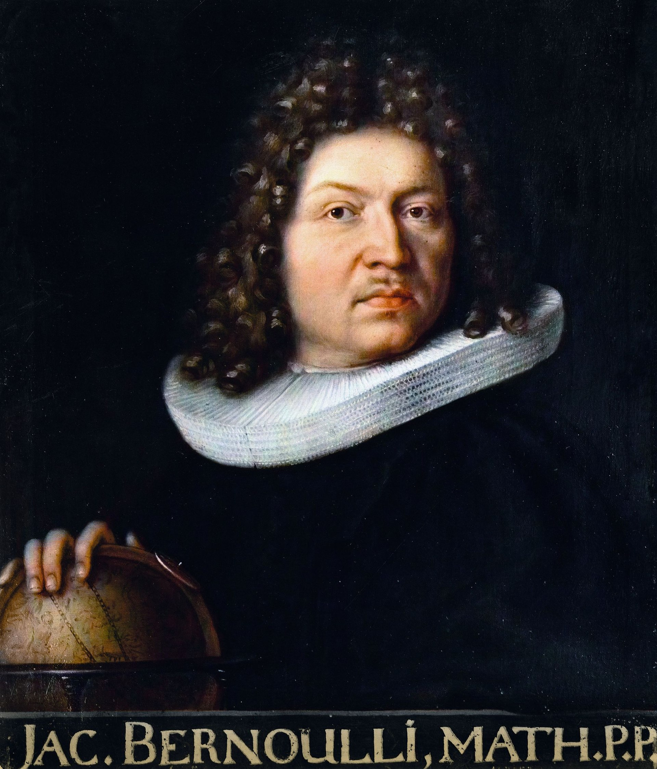
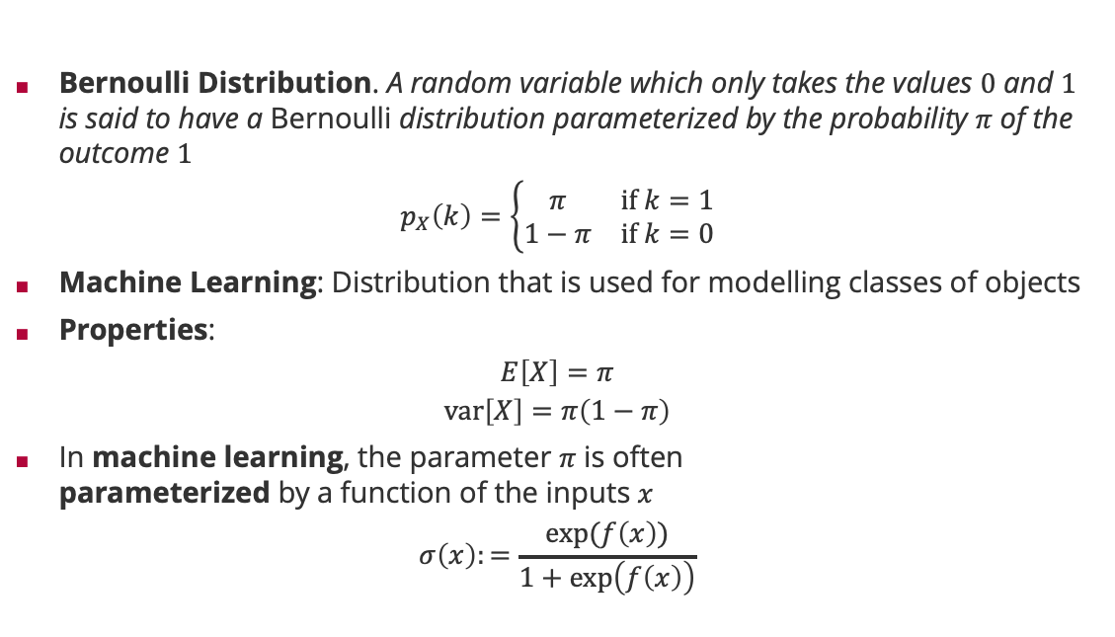
Probability Distributions: Bernoulli
Bernoulli Distribution. A random variable which only takes the values $0$ and $1$ is said to have a Bernoulli distribution parameterized by the probability $π$ of the outcome $1$
$$p_{X}\left(k\right)=\left\{\begin{matrix}π & if k=1 \\ 1−π & if k=0\end{matrix}\right.$$
Machine Learning: Distribution that is used for modelling classes of objects
Properties:
$$E\left[X\right]=π$$
$$var\left[X\right]=π\left(1−π\right)$$
In machine learning, the parameter $π$ is often parameterized by a function of the inputs $x$
$$σ\left(x\right):=\frac{\exp{(f\left(x\right))}}{1+\exp\left(f\left(x\right)\right)}$$
Jacob Bernoulli (1655 – 1705)

Slide 28

Probability Distributions: Logistic Function $σ\left(x\right)$
$$σ\left(x\right)≔1−σ\left(−x\right)$$

Slide 29
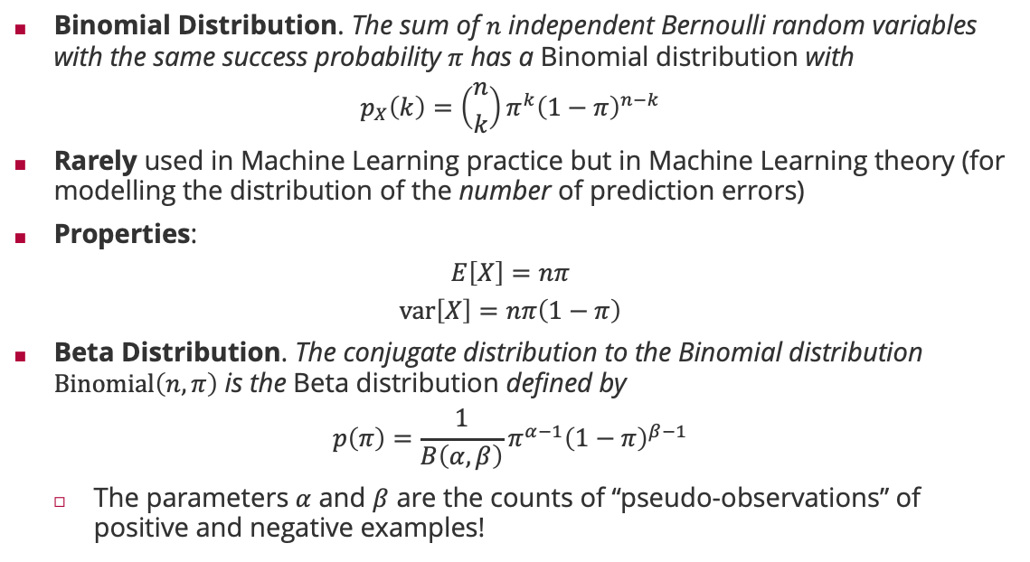
Probability Distributions: Binomial & Beta Distribution
Binomial Distribution. The sum of $n$ independent Bernoulli random variables with the same success probability $π$ has a Binomial distribution with
$$p_{X}\left(k\right)=\left({n \atop k}\right)π^{k}{\left(1−π\right)}^{n−k}$$
Rarely used in Machine Learning practice but in Machine Learning theory (for modelling the distribution of the number of prediction errors)
Properties:
$$E\left[X\right]=nπ$$
$$var\left[X\right]=nπ\left(1−π\right)$$
Beta Distribution. The conjugate distribution to the Binomial distribution $Binomial\left(n,π\right)$ is the Beta distribution defined by
$$p\left(π\right)=\frac{1}{B\left(α,β\right)}π^{α−1}{\left(1−π\right)}^{β−1}$$
The parameters $α$ and $β$ are the counts of “pseudo-observations” of positive and negative examples!
Jacob Bernoulli (1655 – 1705)

Slide 30
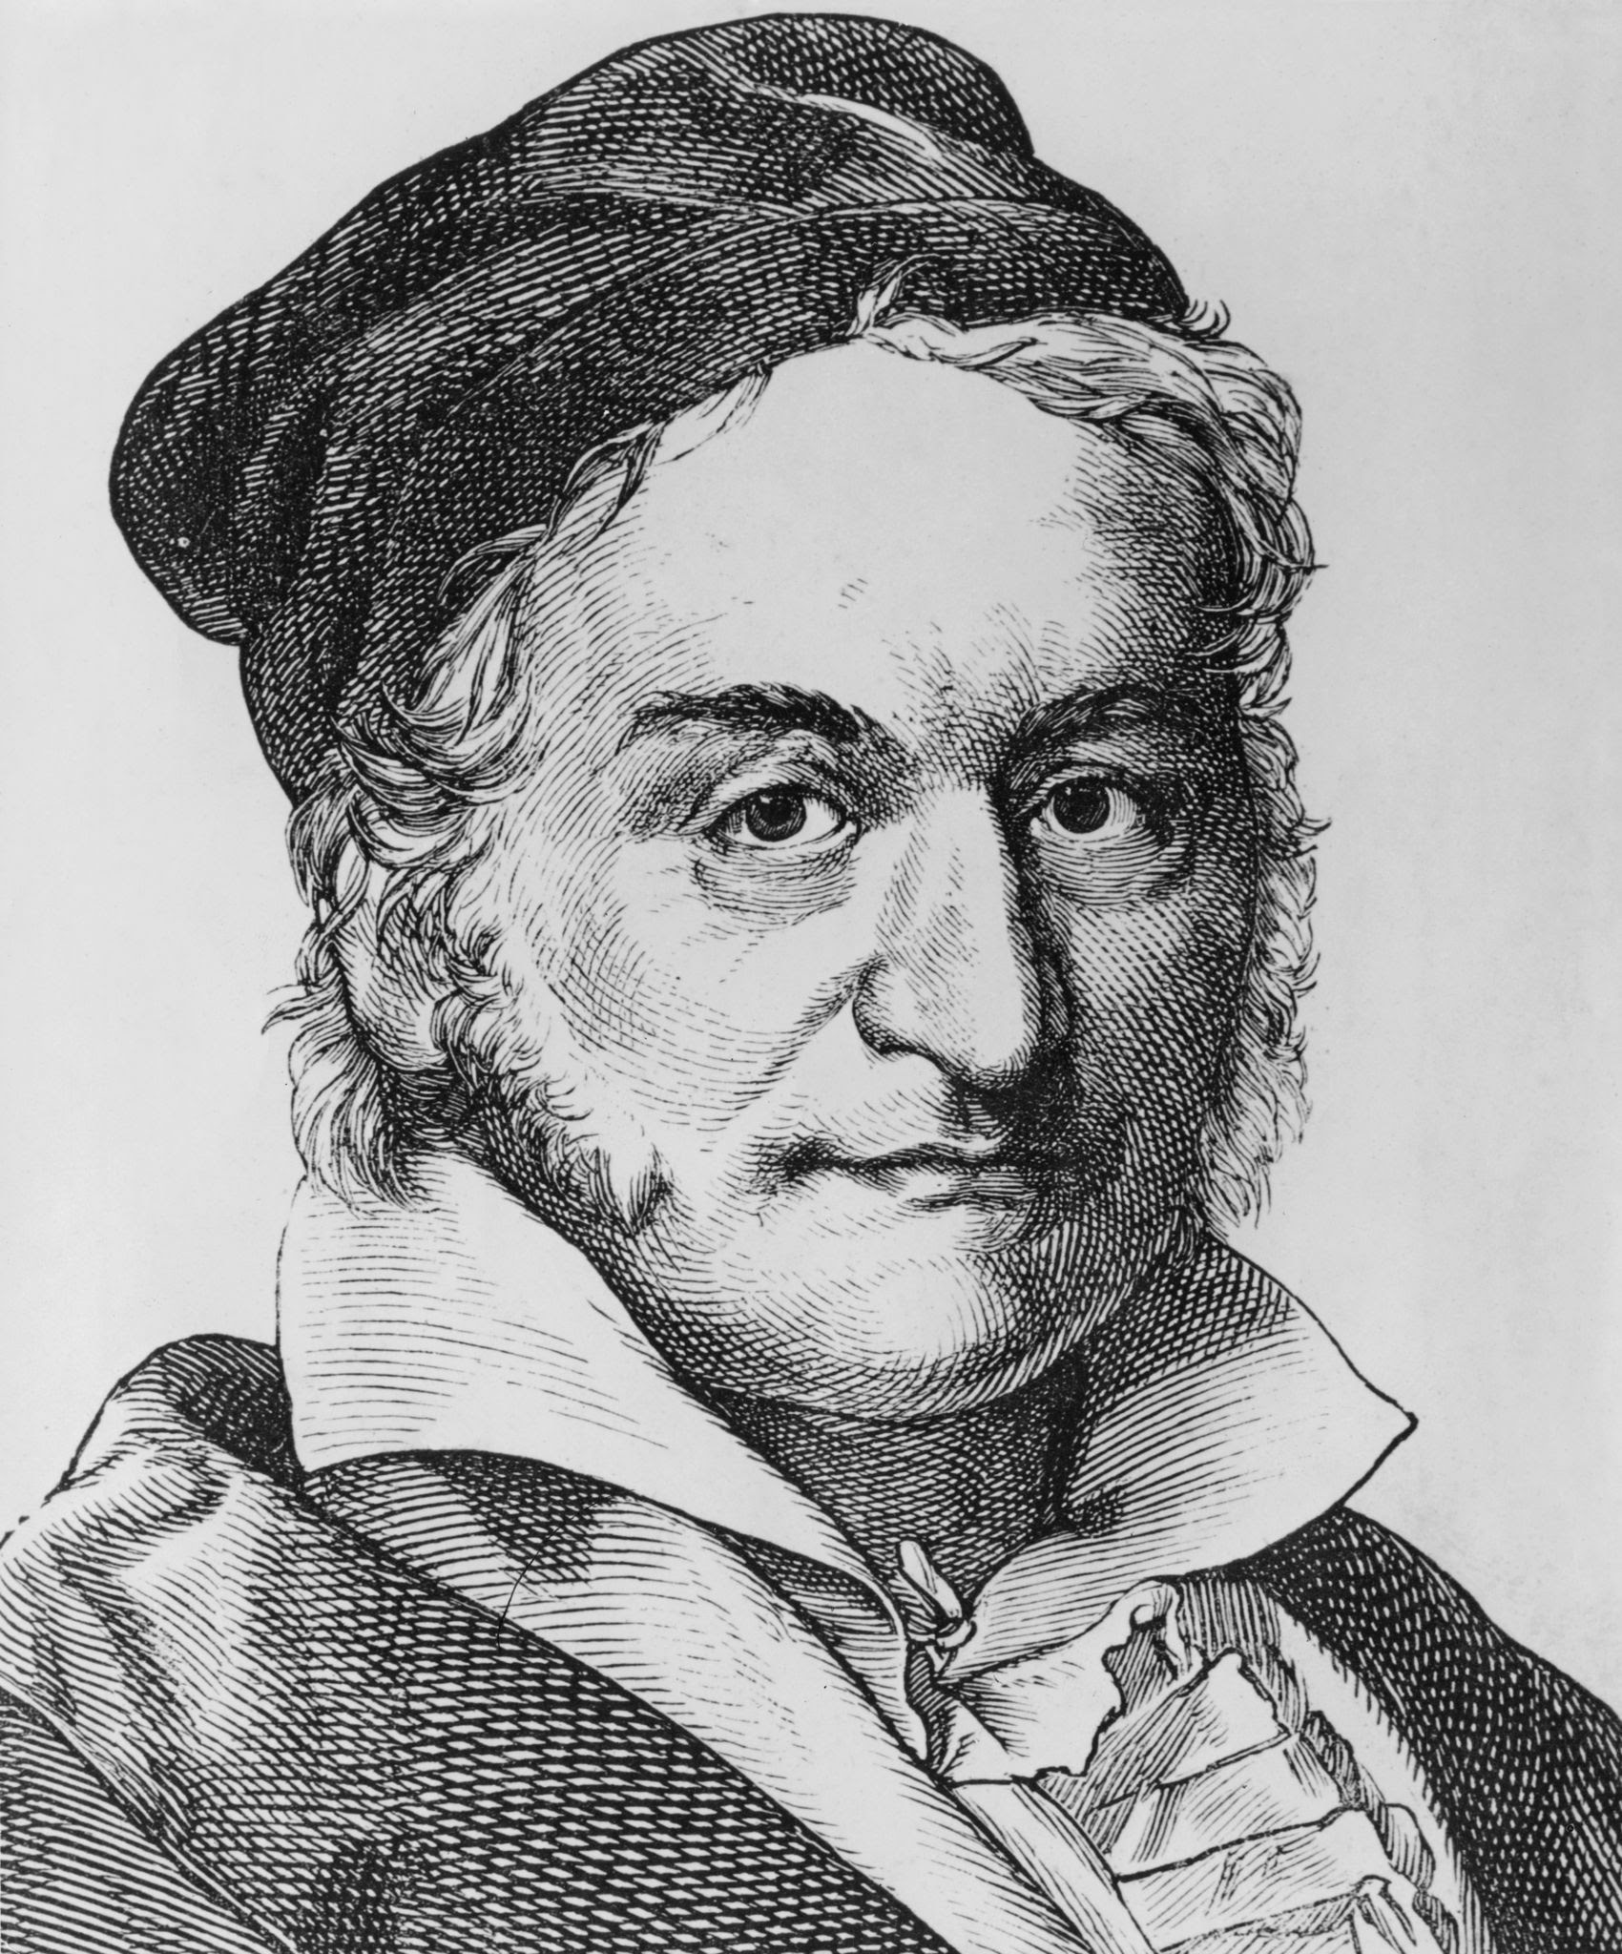
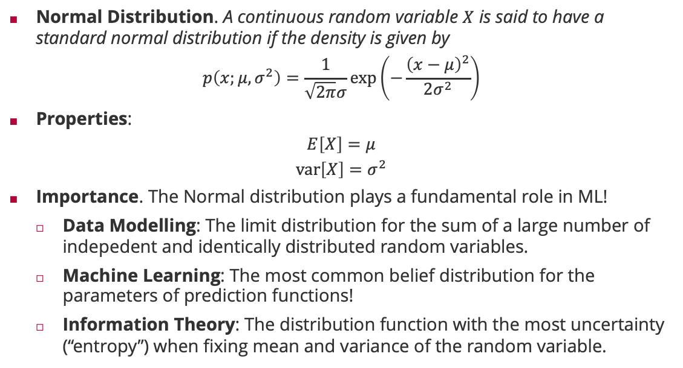
Probability Distributions: Normal
Normal Distribution. A continuous random variable $X$ is said to have a standard normal distribution if the density is given by
$$p\left(x;μ,σ^{2}\right)=\frac{1}{\sqrt{2π}σ}\exp\left(−\frac{{\left(x−μ\right)}^{2}}{2σ^{2}}\right)$$
Properties:
$$E\left[X\right]=μ$$
$$var\left[X\right]=σ^{2}$$
Importance. The Normal distribution plays a fundamental role in ML!
Data Modelling: The limit distribution for the sum of a large number of indepedent and identically distributed random variables.
Machine Learning: The most common belief distribution for the parameters of prediction functions!
Information Theory: The distribution function with the most uncertainty (“entropy”) when fixing mean and variance of the random variable.
Carl Friedrich Gauss (1777 - 1855)

Slide 31
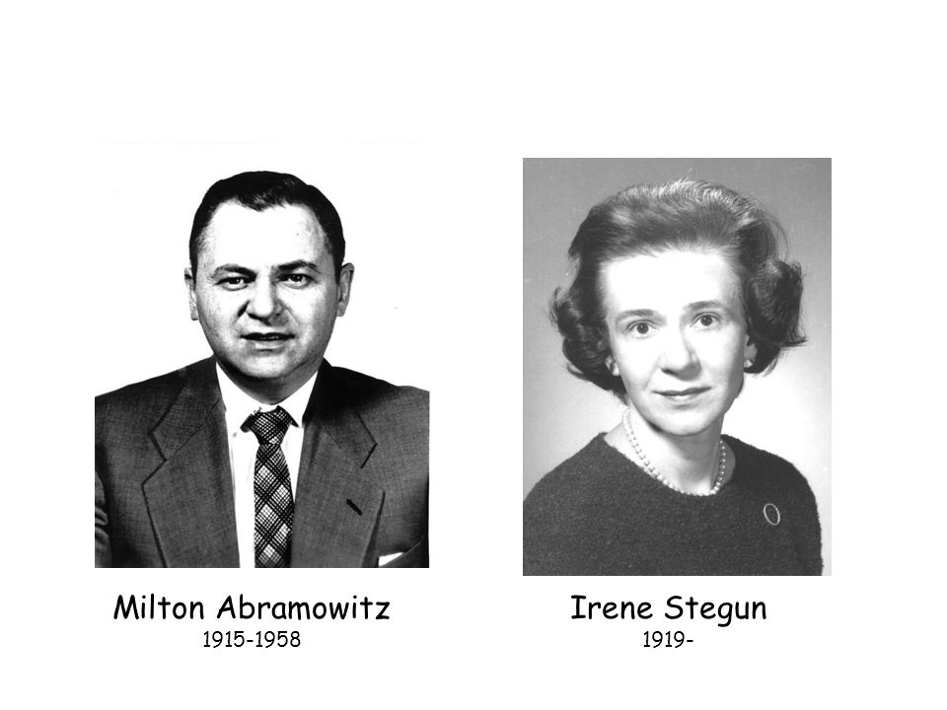
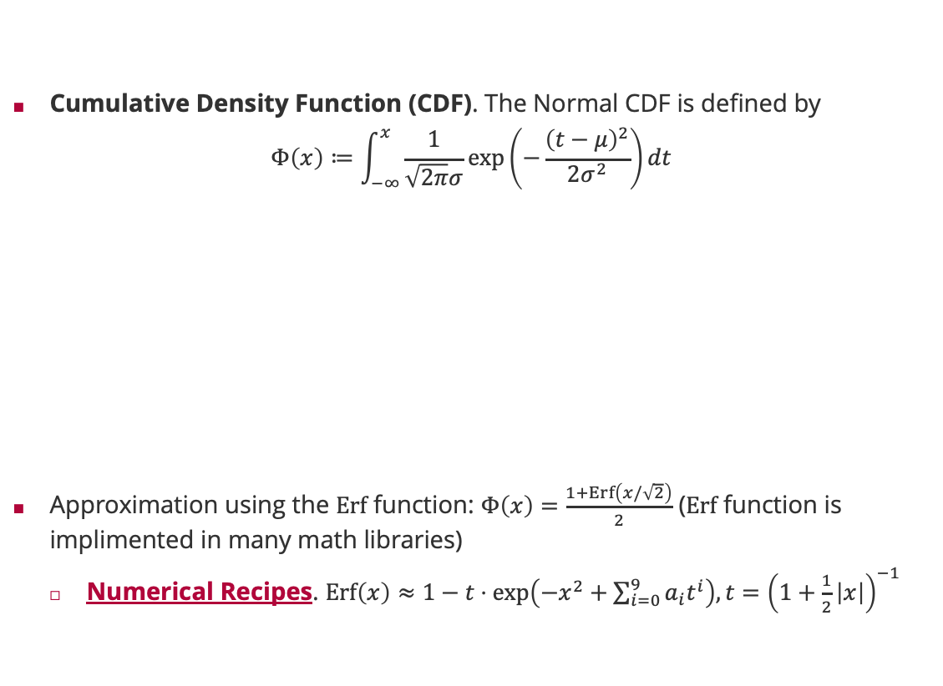
Probability Distribution: Normal (ctd)
Cumulative Density Function (CDF). The Normal CDF is defined by
$$Φ\left(x\right)≔\int_{−∞}^{x}{\frac{1}{\sqrt{2π}σ}\exp\left(−\frac{{\left(t−μ\right)}^{2}}{2σ^{2}}\right)dt}$$
Approximation using the $Erf$ function: $Φ\left(x\right)=\frac{1+Erf\left(x/\sqrt{2}\right)}{2}$ ($Erf$ function is implimented in many math libraries)
Numerical Recipes. $Erf\left(x\right)≈1−t⋅\exp\left(−x^{2}+\sum_{i=0}^{9}{a_{i}t^{i}}\right), t={\left(1+\frac{1}{2}\left|x\right|\right)}^{−1}$

Slide 32
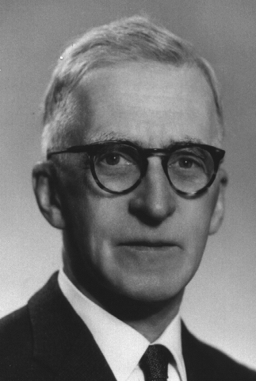
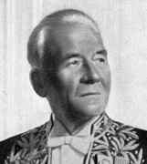
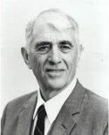


Probability Distributions: Exponential Family
Exponential Family. A family of distributions is said to belong to the exponential family if the probability density/mass function in terms of the parameterisation $θ$ is
$$p\left(x\right)=h\left(x\right)⋅\exp\left(\sum_{i}{η_{i}\left(θ\right)⋅T_{i}\left(x\right)}−A\left(θ\right)\right)$$
The $η_{i}$ are called canonical parameters and the $T_{i}$ are called sufficient statistics.
Big Advantage: Closed and efficient under multiplication (Bayes’ rule!)
$$p\left(x;η_{1}\right)⋅p\left(x;η_{2}\right)=p\left(x;η_{1}+η_{2}\right)$$
Edwin Pitman (1897 - 1993)
Georges Darmois (1888 - 1960)
Distribution $p(x)$ | Canonical Parameters | Sufficient Statistic
$$Bin\left(x;n,π\right)$$ | $$\log\left(\frac{π}{1−π}\right)$$ | $$x$$
$$Beta\left(π;α,β\right)$$ | $$\left[α,β\right]$$ | $$\left[\log\left(π\right),\log\left(1−π\right)\right]$$
$$𝒩\left(x;μ,σ^{2}\right)$$ | $$\left[\frac{μ}{σ^{2}},\frac{1}{σ^{2}}\right]$$ | $$\left[x,x^{2} \right]$$
Bernhard Koopman (1900 - 1991)

Slide 33
Summary
History of Machine Learning
Machine learning is a 70-year-old field of research
Key step in artificial intelligence improving on a task based on data
Probability in Machine Learning
Probability is not a physical quantity but a mathematical model of uncertainty
Two different axiomatic justifications of the same math: one for data and one for parameters!
Probability Theory
Two key rules of probability theory: Sum rule & Product (Bayes’) rule
Independence is a concept of probability; it does not require random variables!
A random variable is a real-valued function of the outcome of the experiment
Probability Distributions
The Bernoulli distribution with a sigmoid link function is key for classification learning
The normal distribution is centrally important in probabilistic machine learning

Slide 34
See you next week!

